Slide 1
Disease Diagnosis

Slide 2
Presented by
Nitin Singh-1809710065
Nitin Kumar yadav-1809710064
Under the Guidance of
Mr. mayank Dixit
Mr. t.Akilan

Slide 3
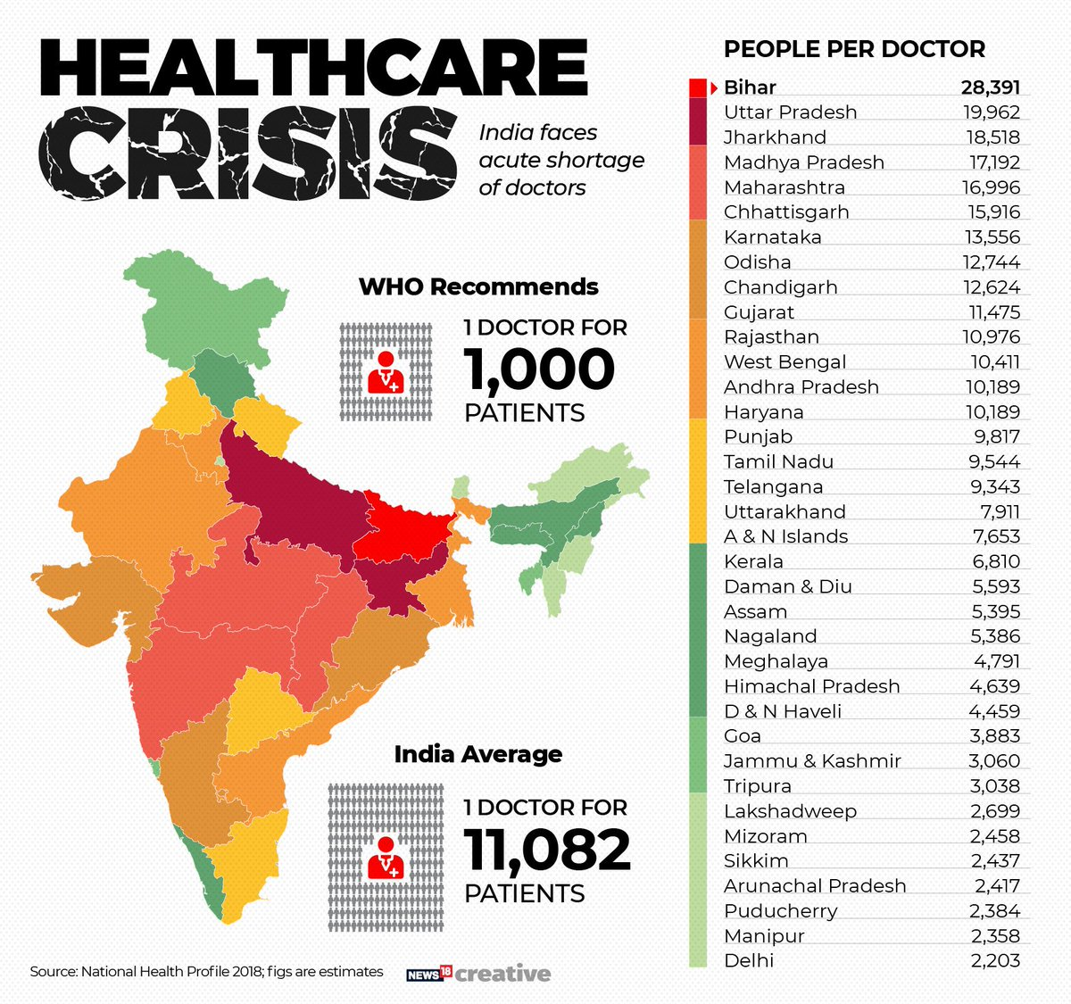


Problem
Daily increase in Patient per Doctor ratio.
In the country of 135.26 crores population there are only 9.27 Lakhs Doctors are available for service.

Slide 4
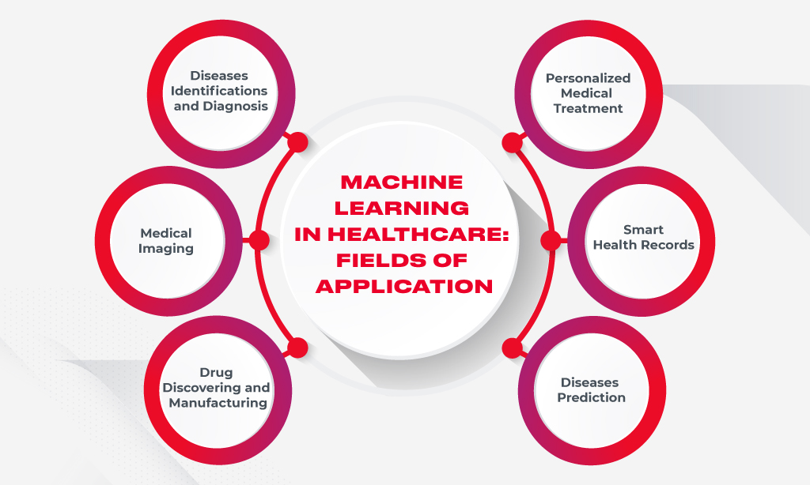
Future of Machine Learning in Healthcare

Slide 5
methodology
Creating a machine learning model for predicting disease.
Using Logistic regression Technique for classification purpose.
Designing a website named as Docmac For providing a interface to the users.

Slide 6
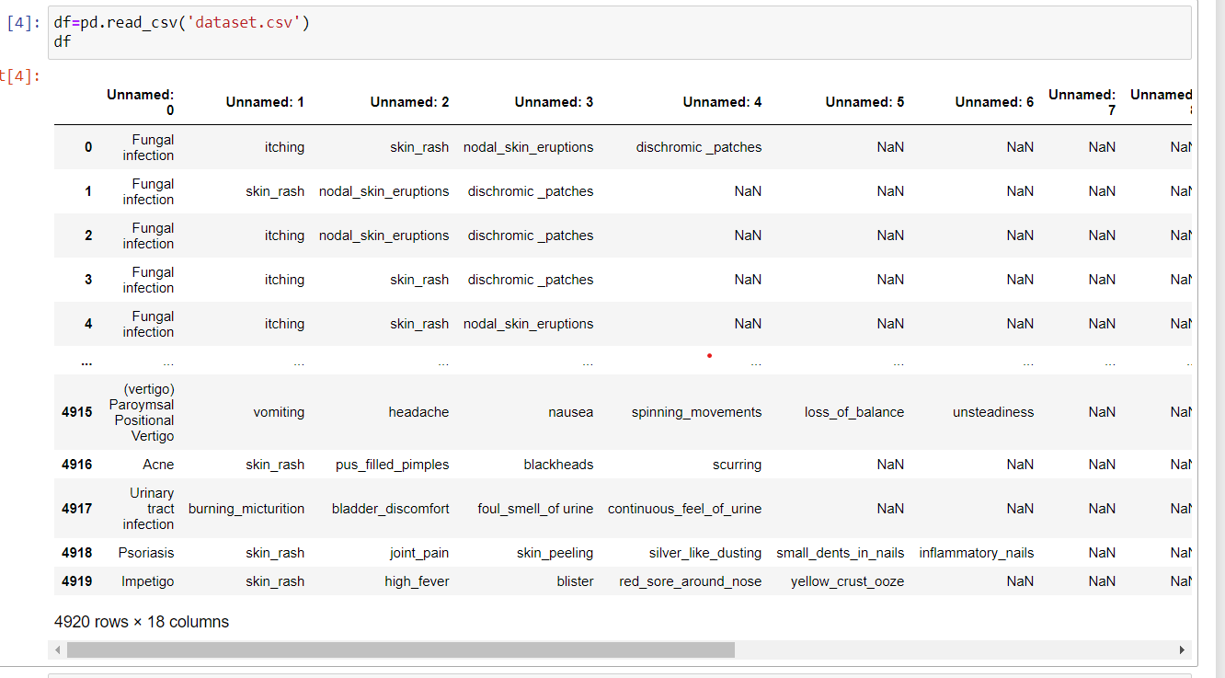
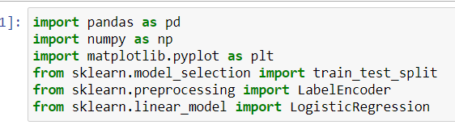
Dataset used
This is a small part of the dataset used for training the ml model containing symptoms combination and their respective disease.
PYTHON MODULE USED-

Slide 7
Tools Used
HTML
CSS
JAVASCRIPT
Python(Pandas, Numpy, Matplotlib, Sklearn, request and Json module)
Bootstrap

Slide 8
Future Scope and enhancement
We can make our prediction more accurate by improvising dataset used.
Using ANN instead of Logistic regression for better predictions.
Implementation of Text to speech system in website to make patient and model interaction more interactive.
Using Medical test reports for better analysis of disease.
Instead of web interface we also create a Graphic User Interface.
Use and link the database for storing the patient records.

Slide 9
Thank YOU

